Slide 1
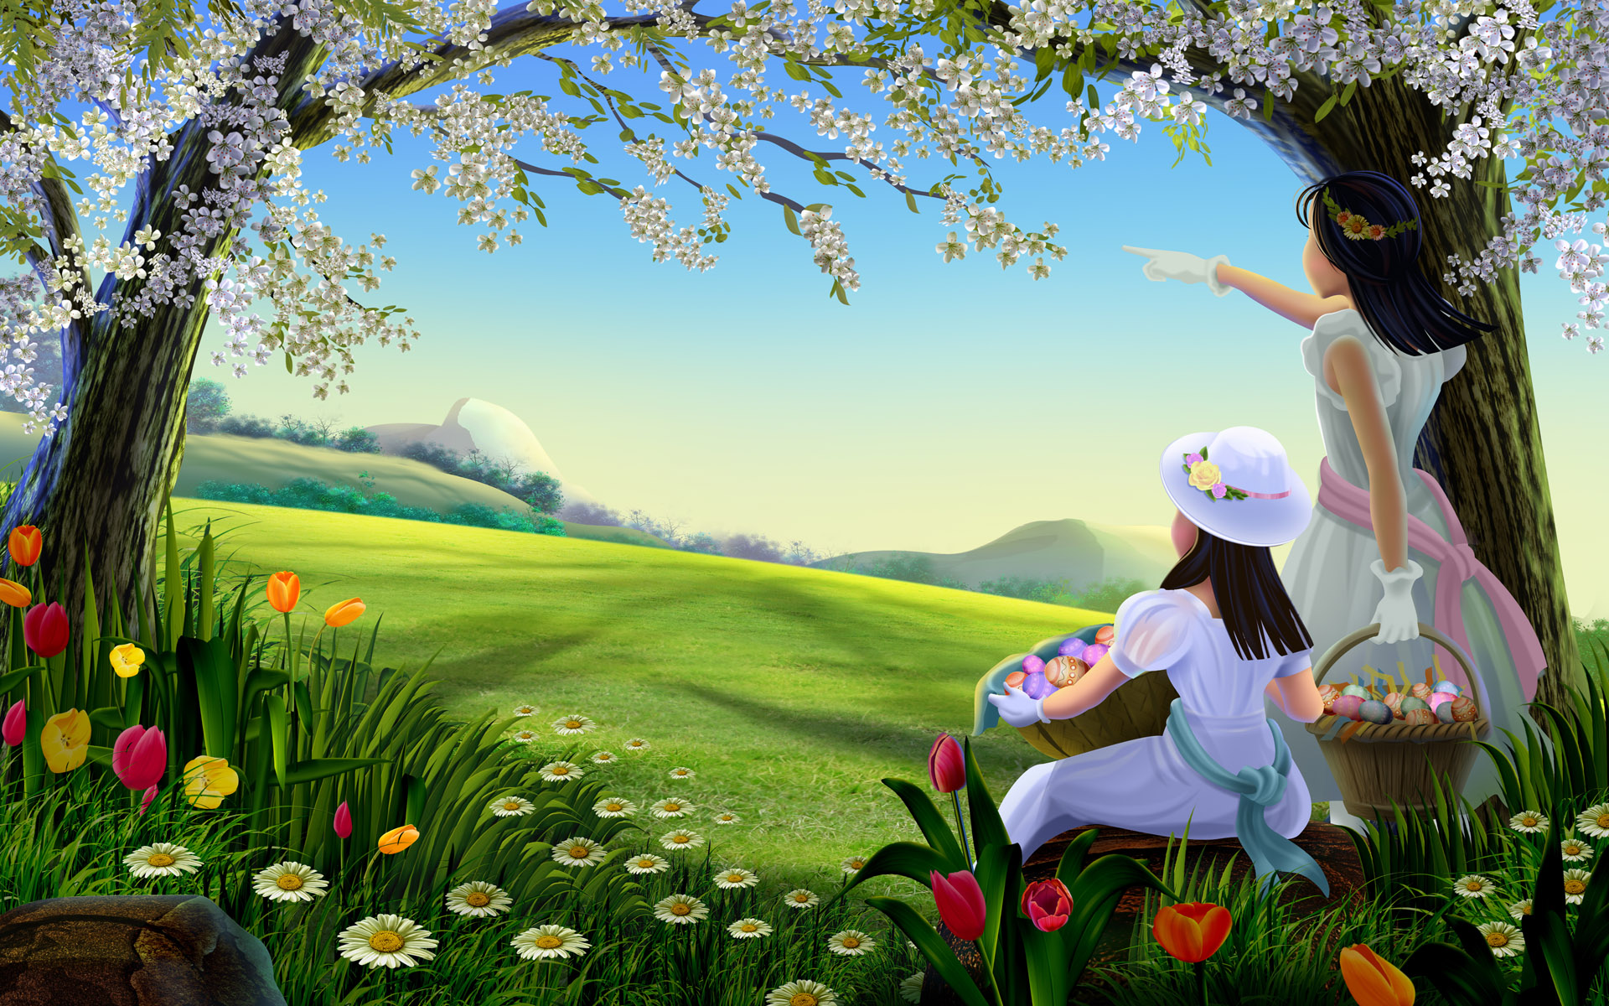
Welcome

Slide 2


Class – Six
Subject – English 2nd Paper
Class duration – 50 minutes
Presented By
Abusufian Azam
01718251111

Slide 3
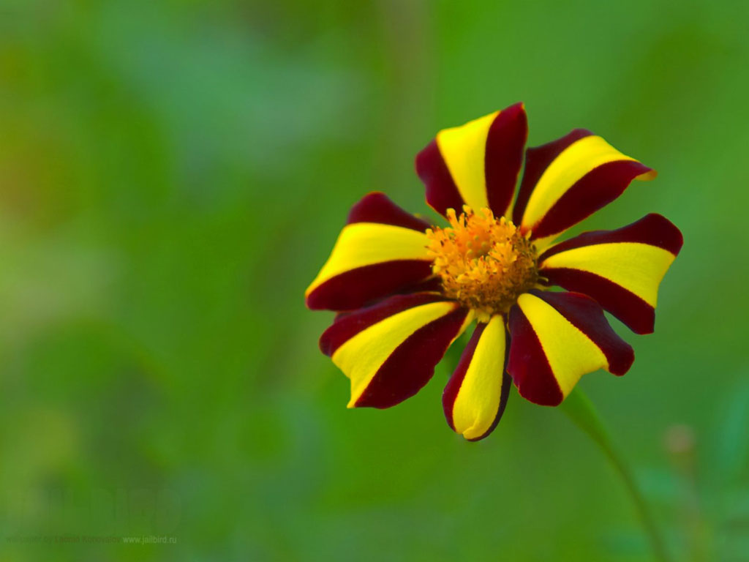
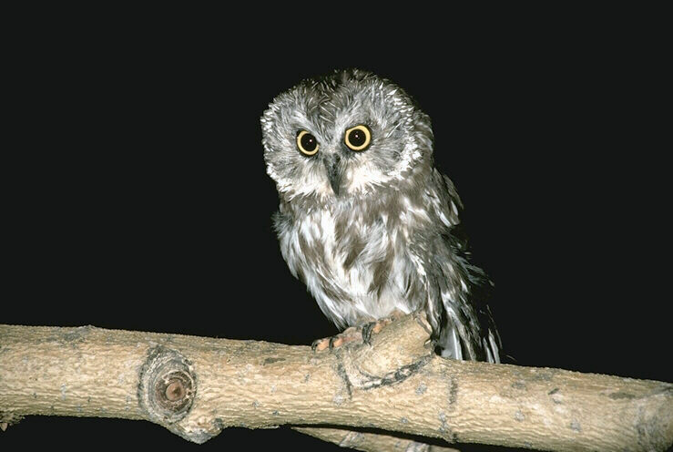
a
This is __ flower.
This is ___owl.
an

Slide 4
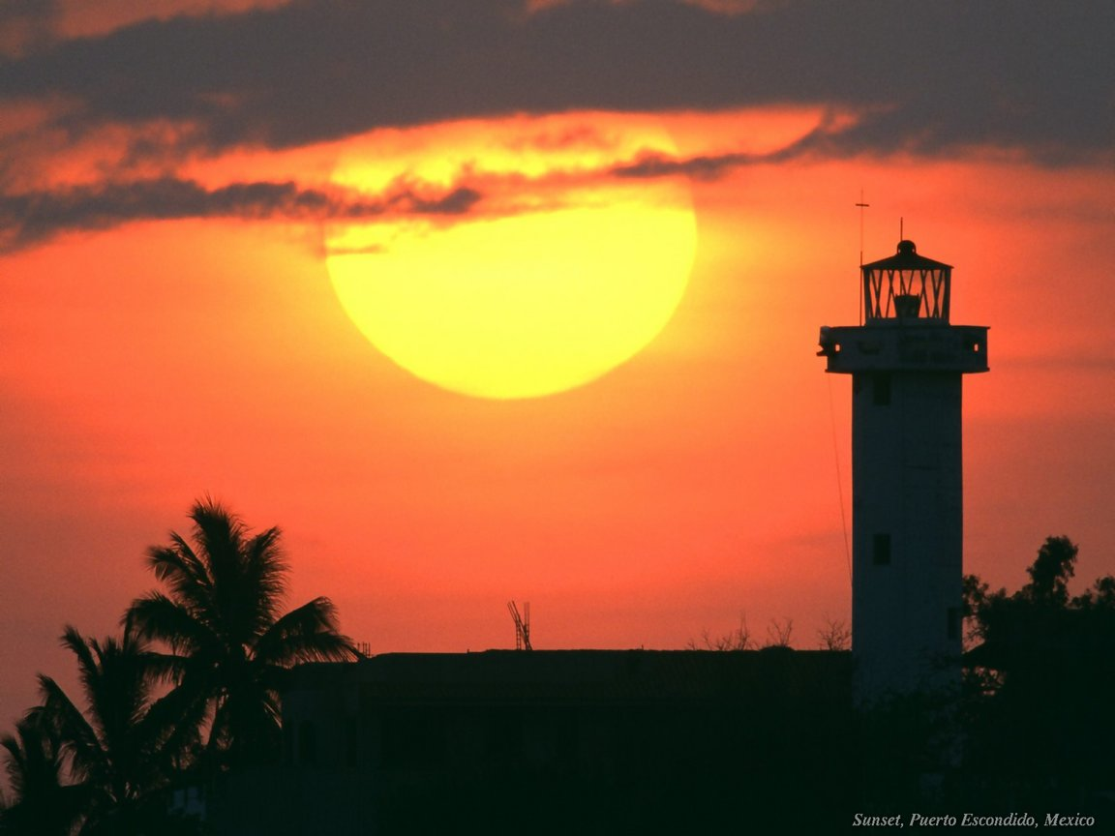
The
____ sun sets on the west.

Slide 5

Today’s Topic
Articles

Slide 6
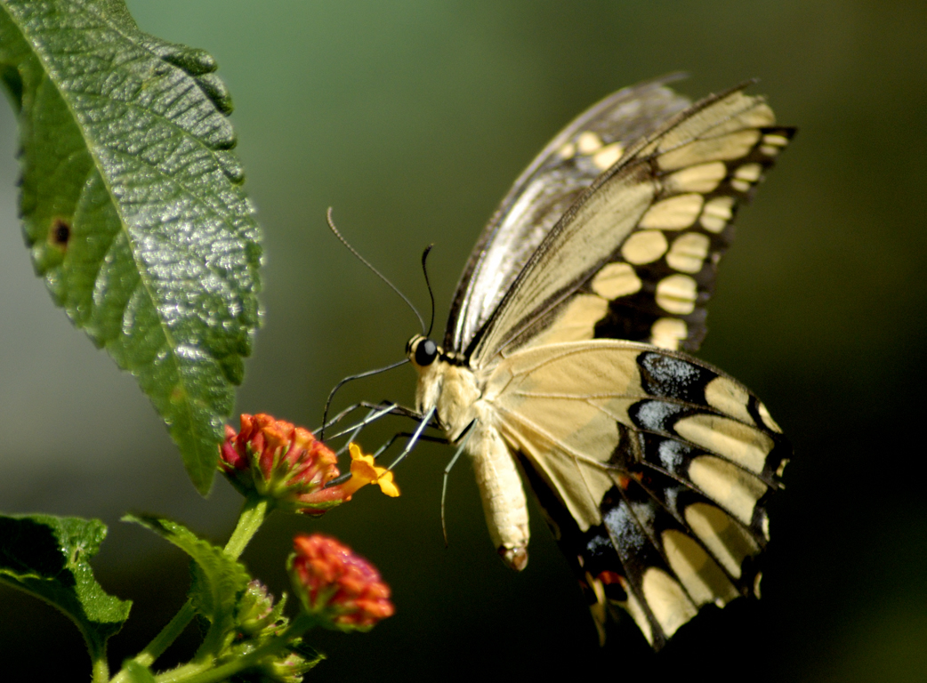
Learning Outcomes
Understand and being able to use a/an.

Slide 7
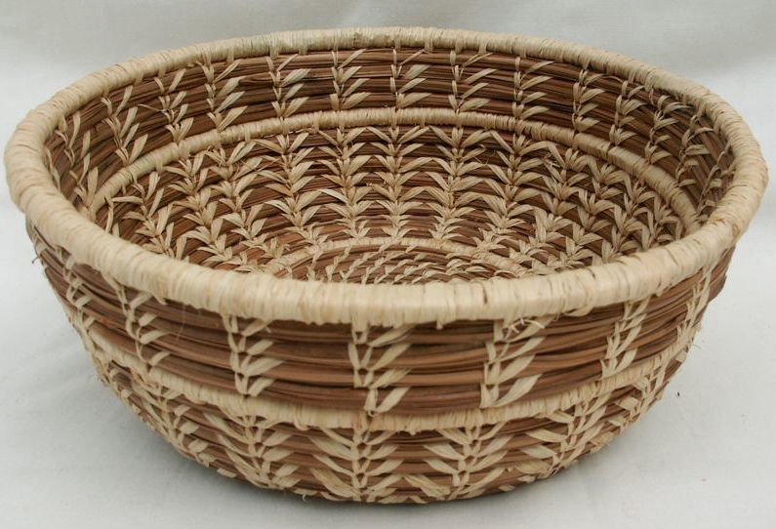
U
O
A
E
I
Vowel

Slide 8
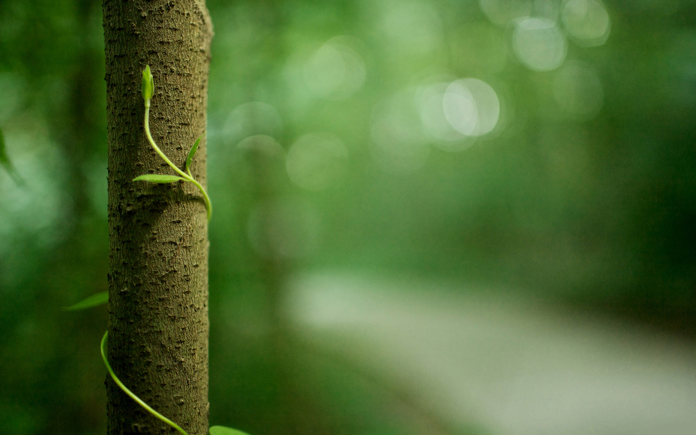
Before vowel we will use ‘an’.
Before consonant we will use ‘a’.

Slide 9
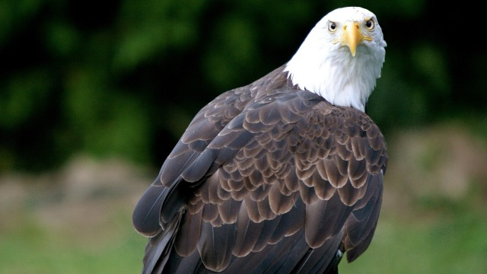
an
My friend looks at like ___ eagle.

Slide 10
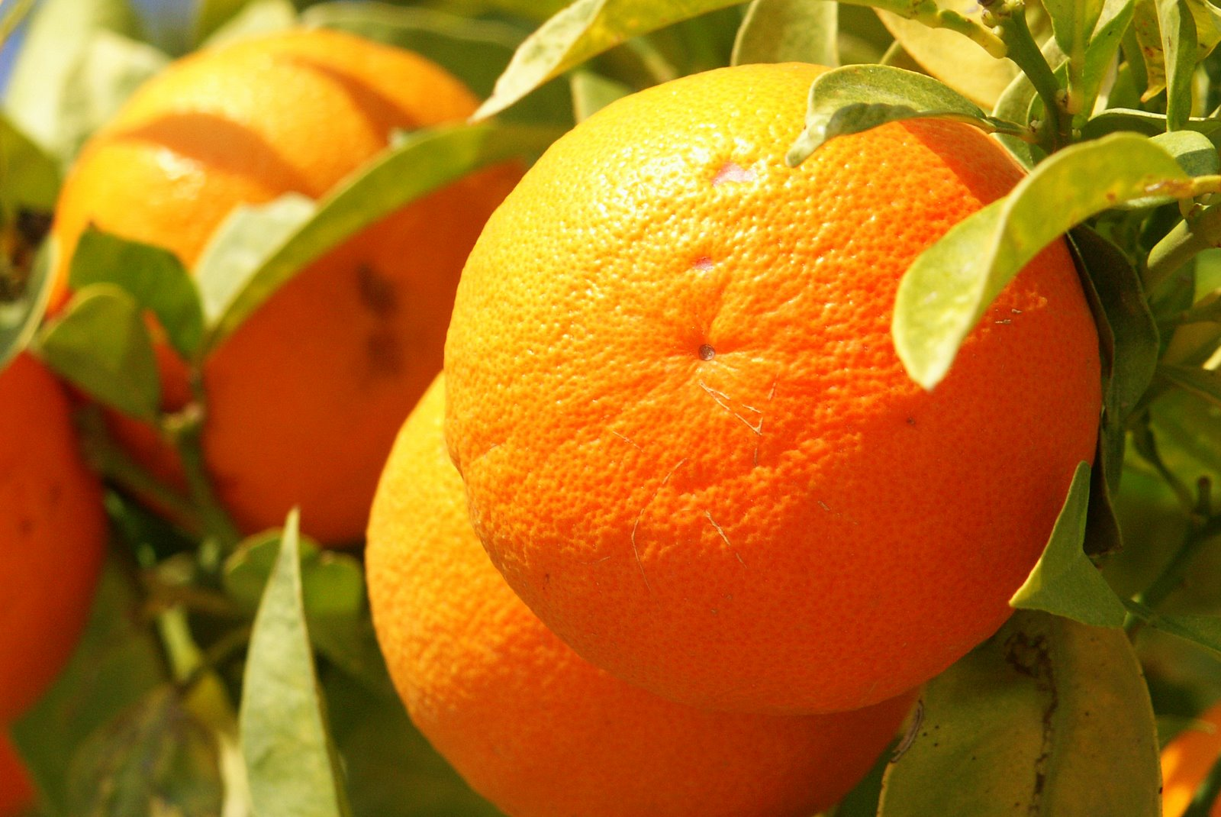
an
Samiya is fond of ___ orange.

Slide 11
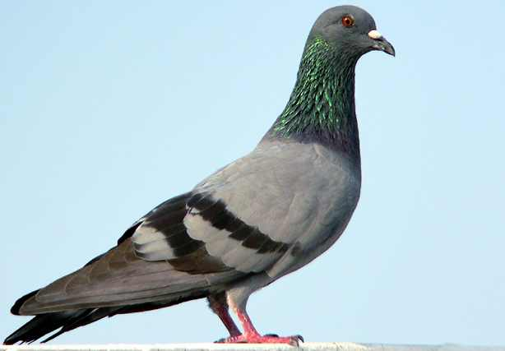
a
The pigeon is ___ pet bird.

Slide 12
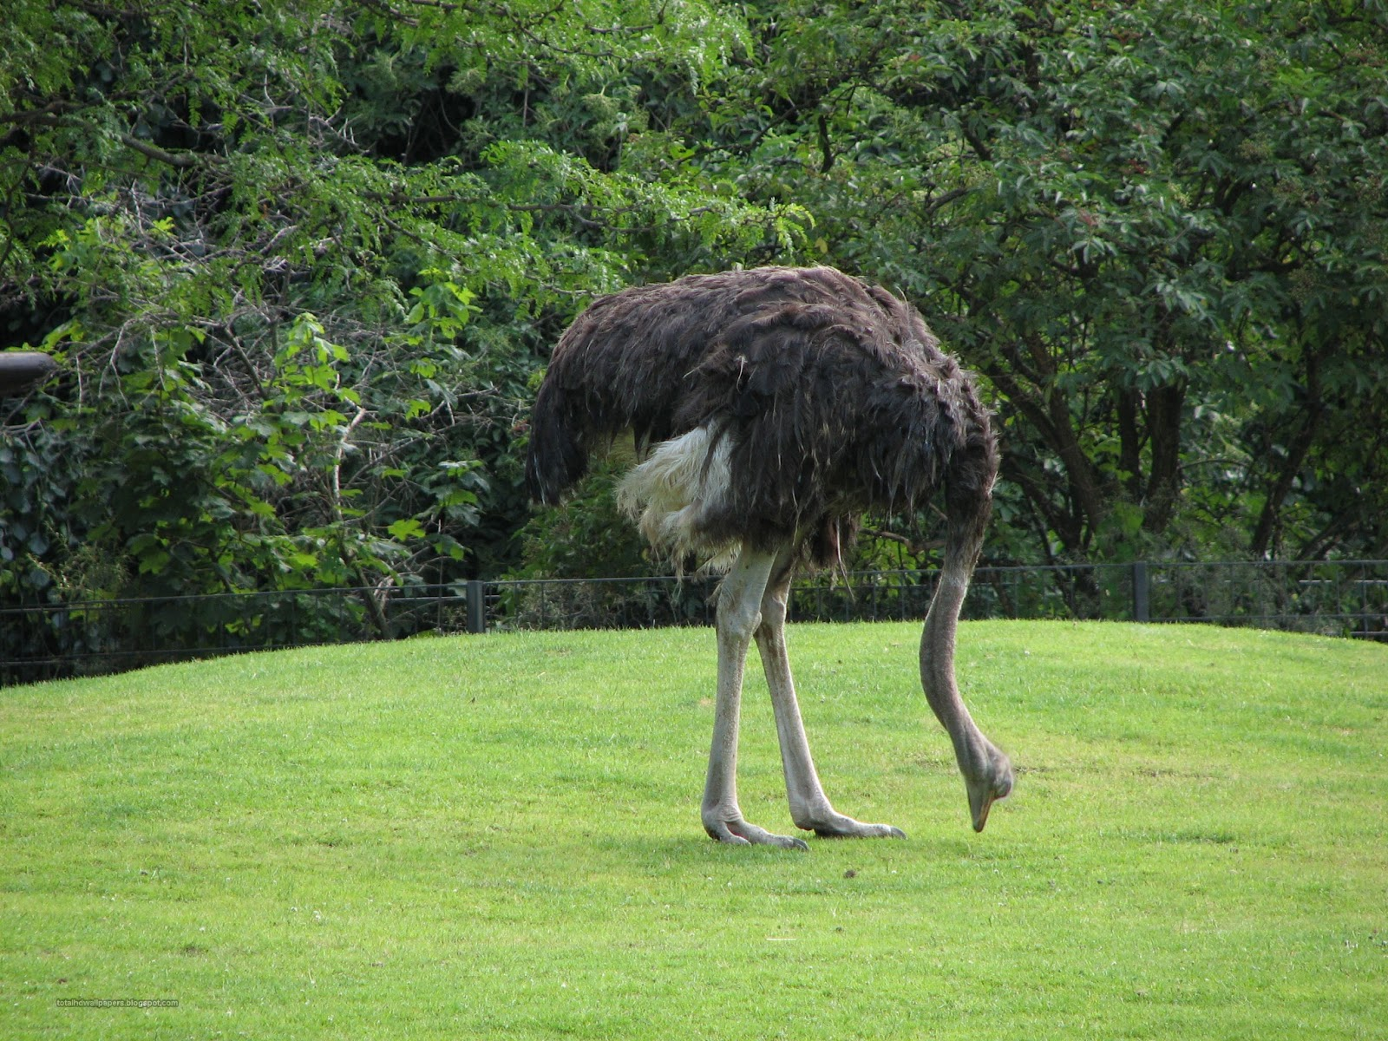
an
It is ___ ostrich.

Slide 13
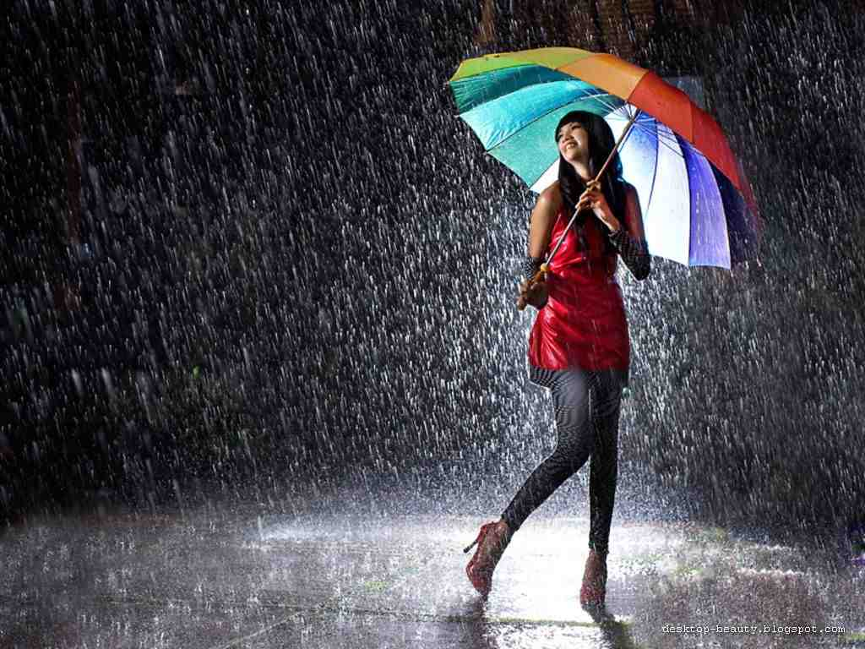
an
She carries ___ umbrella when it rains.

Slide 14
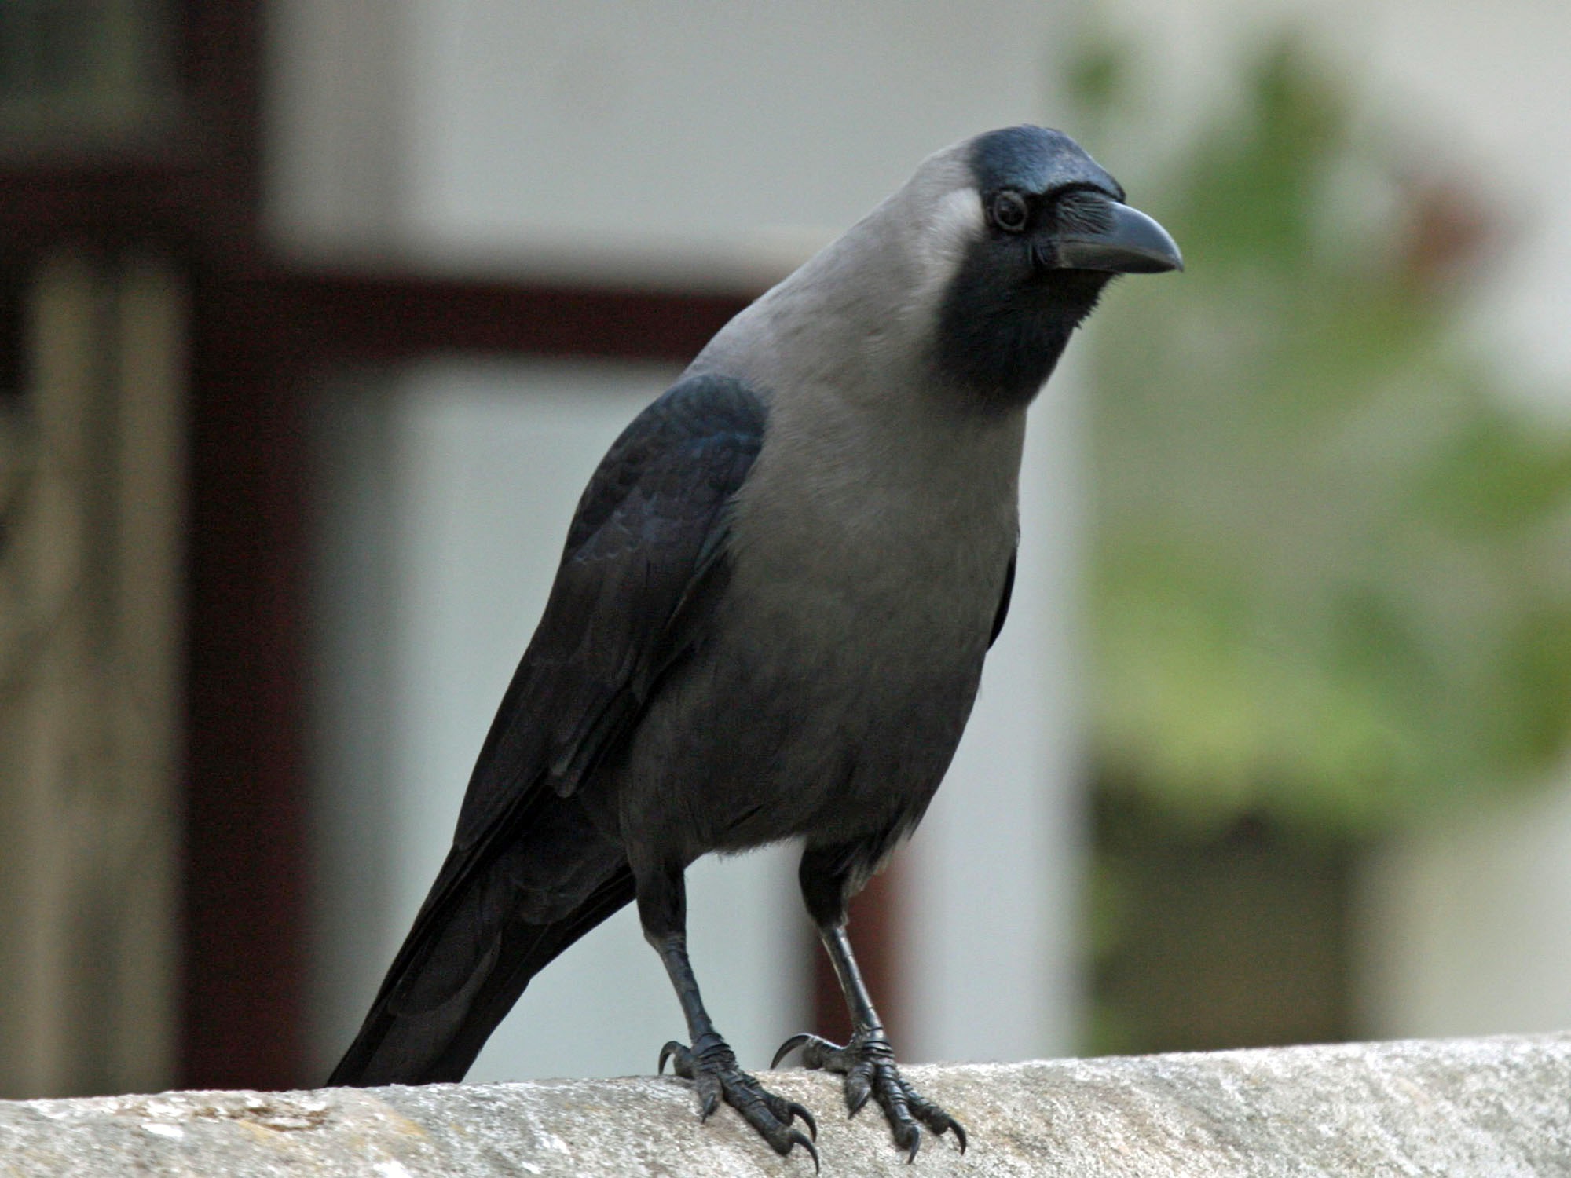
an
The crow is ____ ugly bird.

Slide 15
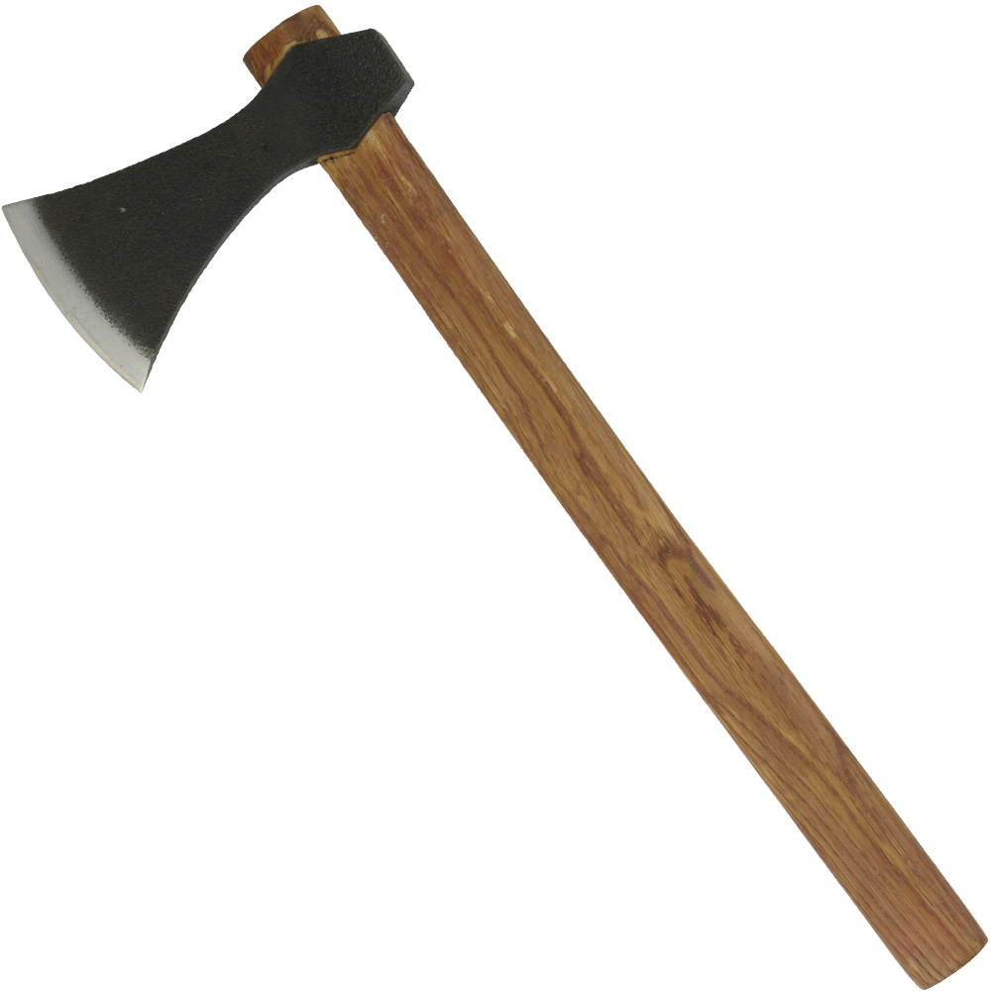
an
The woodcutter uses ____ axe to cut wood.

Slide 16
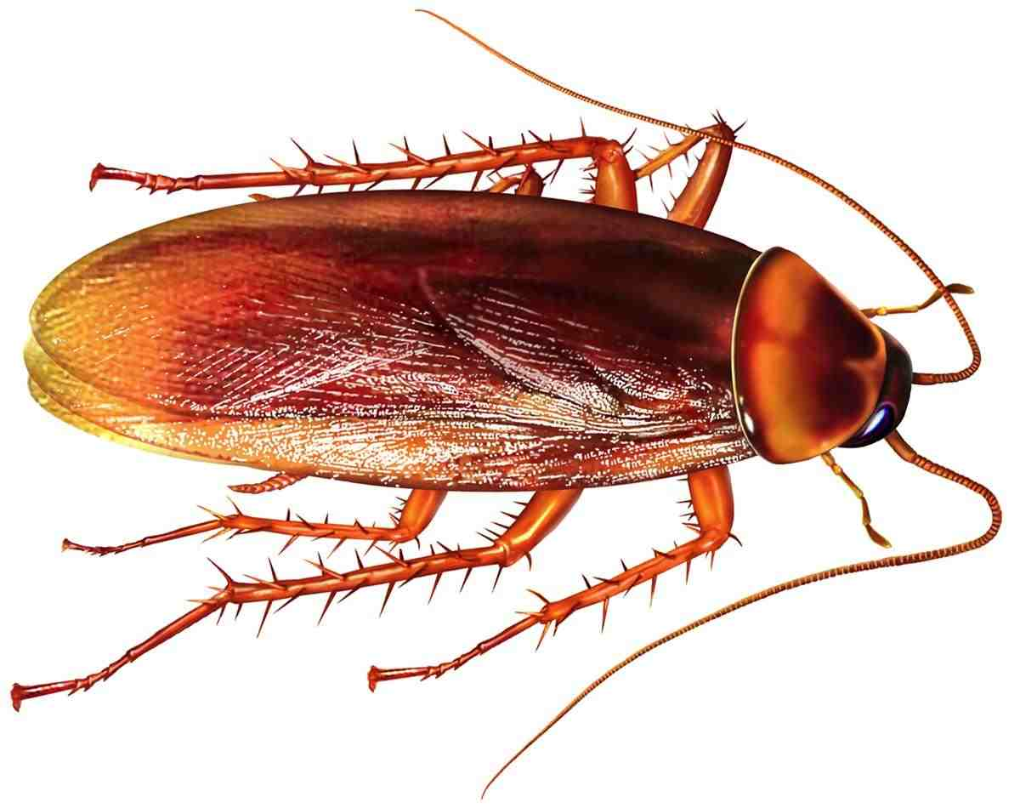
a
Cockroach is __ harmful insect.

Slide 17
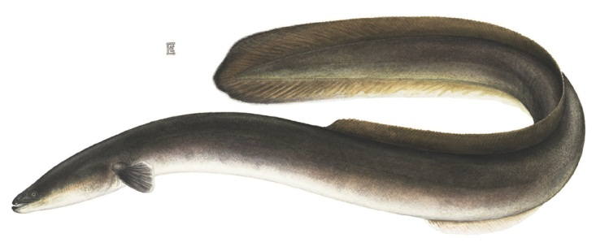
an
It is ___ eel fish.

Slide 18
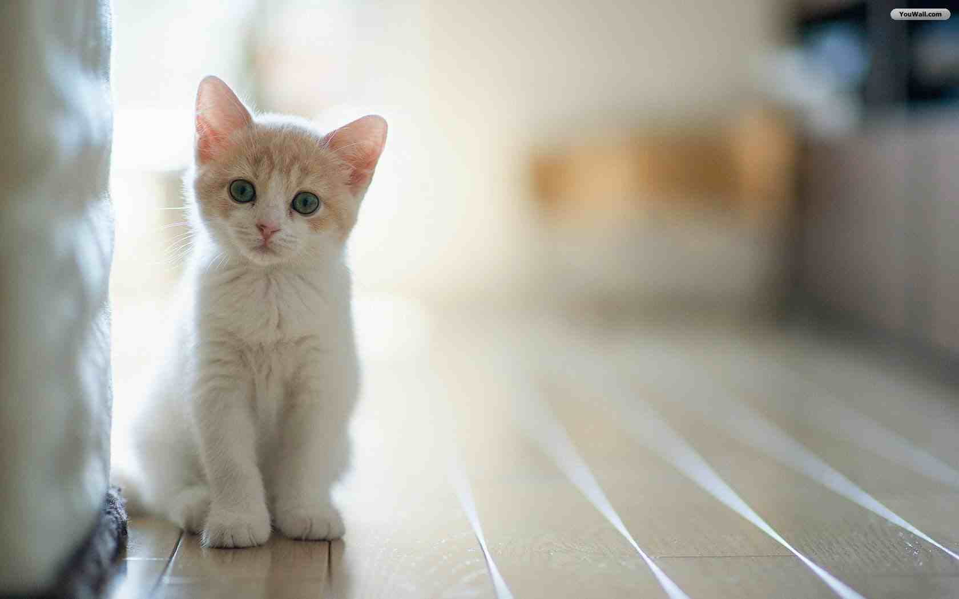
a
I have ___ cat.

Slide 19
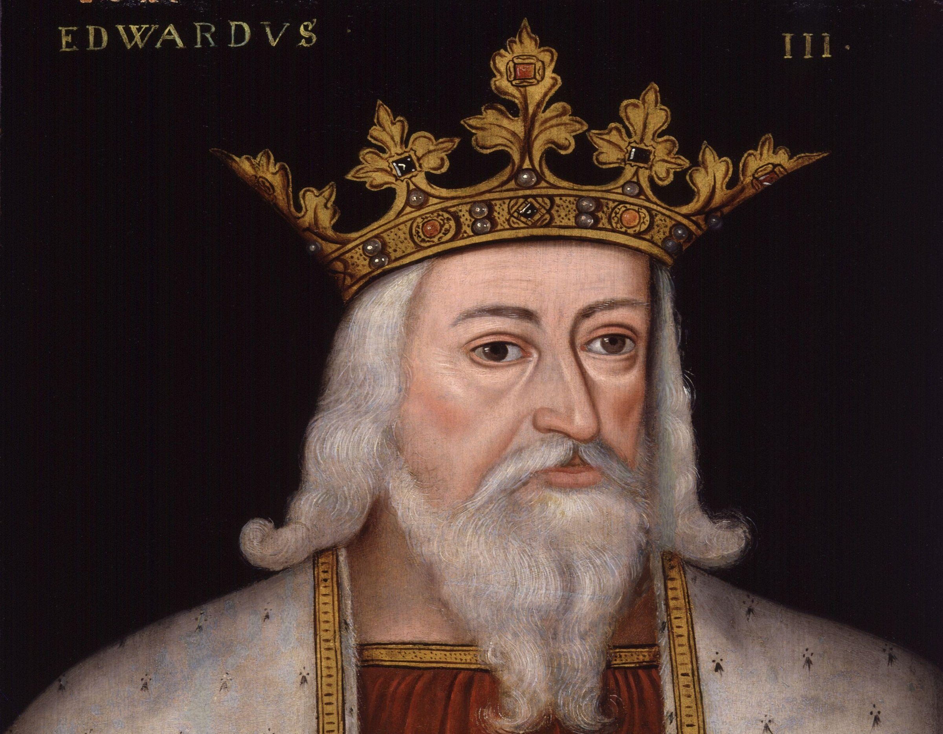
a
The king has __ crown.

Slide 20
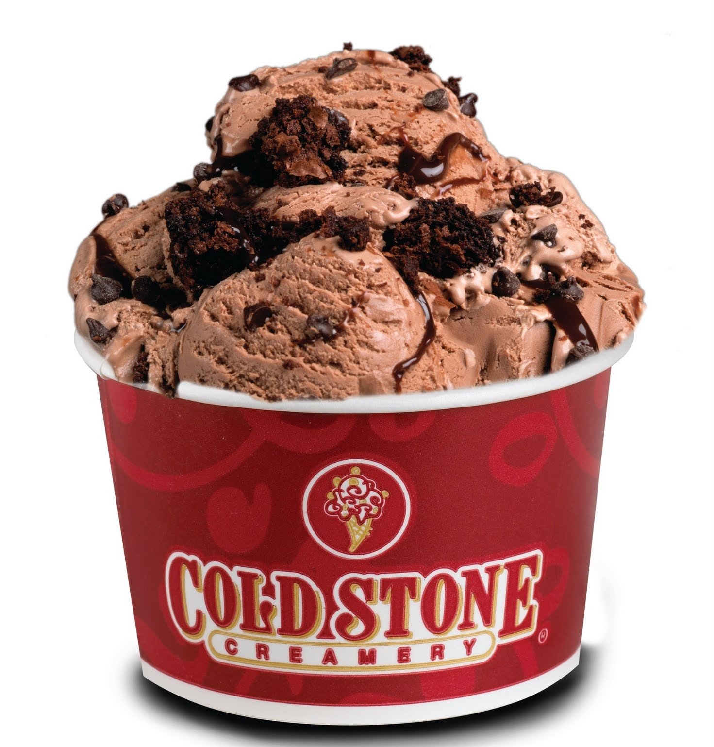
an
I want ___ ice-cream.

Slide 21
Class Work
He has eaten ___ egg.
Rana sees ___ bird.
The baby is crying for ___ doll.
This is ___ interesting story.
She gave me ___ inkpot.

Slide 22
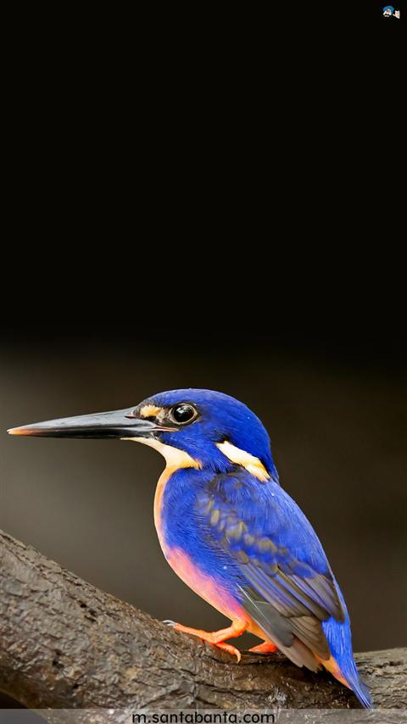
Evaluation
The kingfisher has ___ sharp look.
a

Slide 23
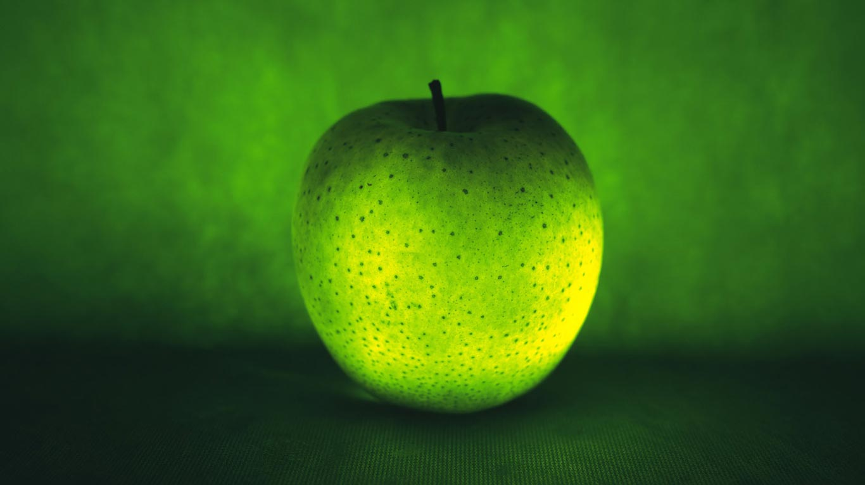
I eat ___ apple daily.
an

Slide 24
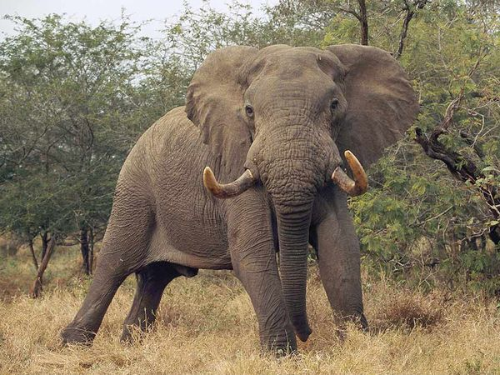
an
The king has ____ elephant.

Slide 25
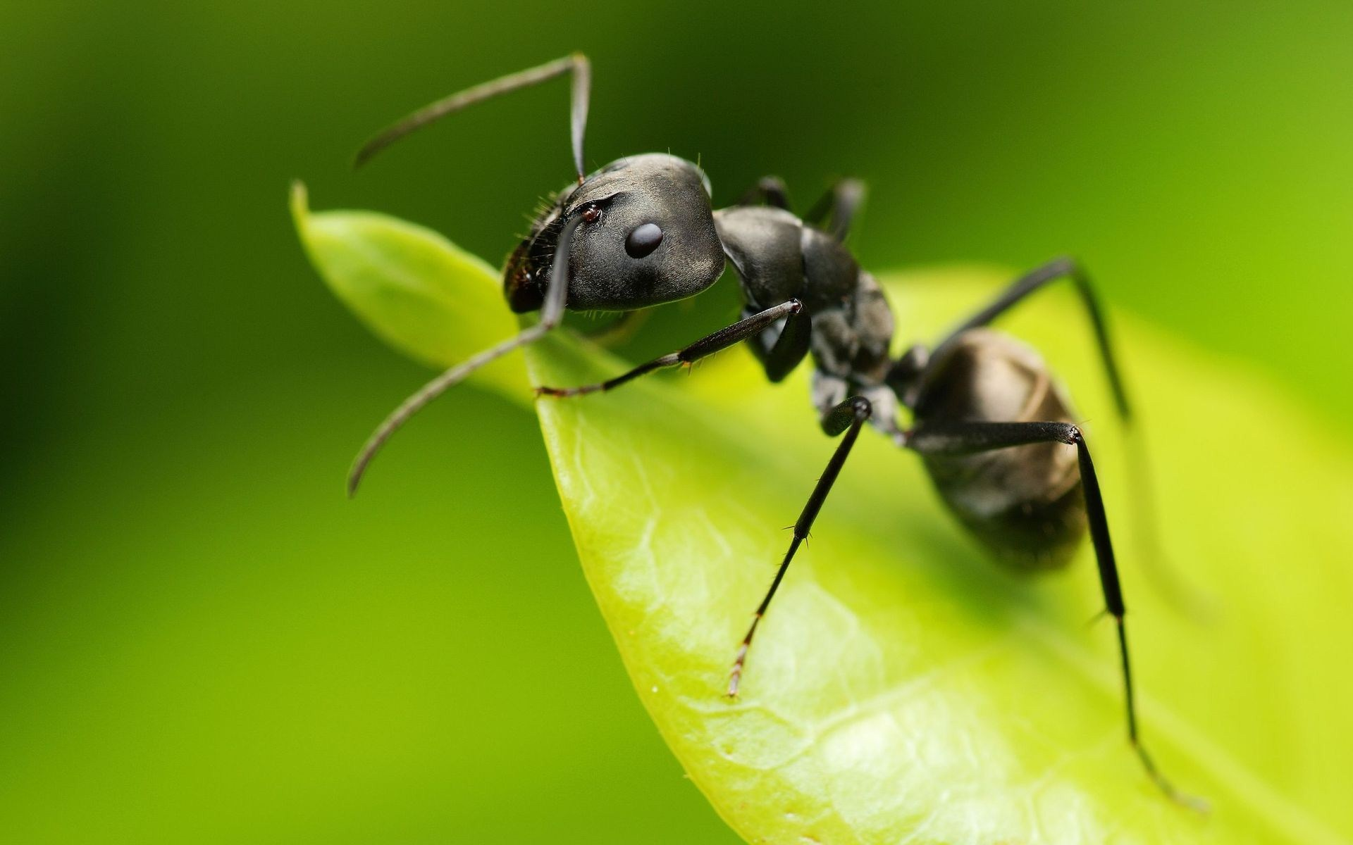
I do not like ___ ant because it bites.
an

Slide 26
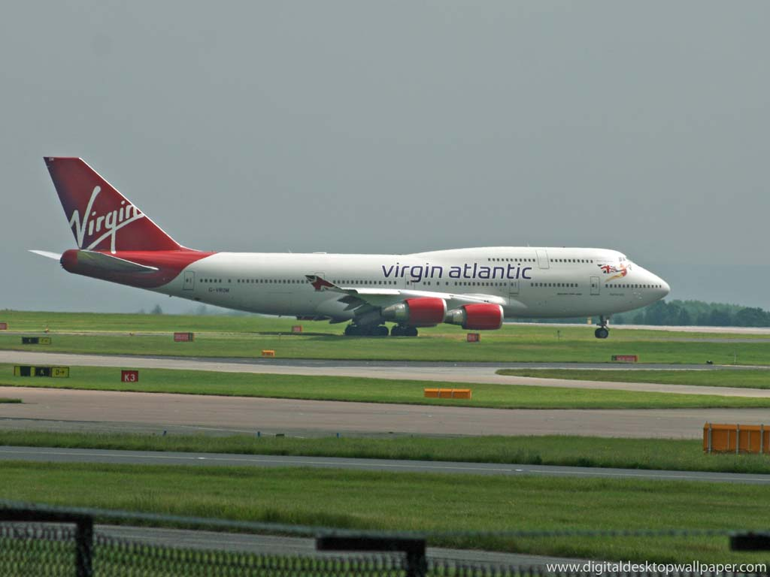
I saw ___ aeroplane at the airport.
an

Slide 27
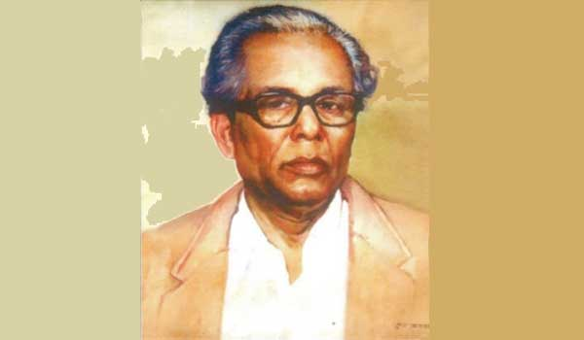
Joynul Abedin was ___ artist.
an

Slide 28
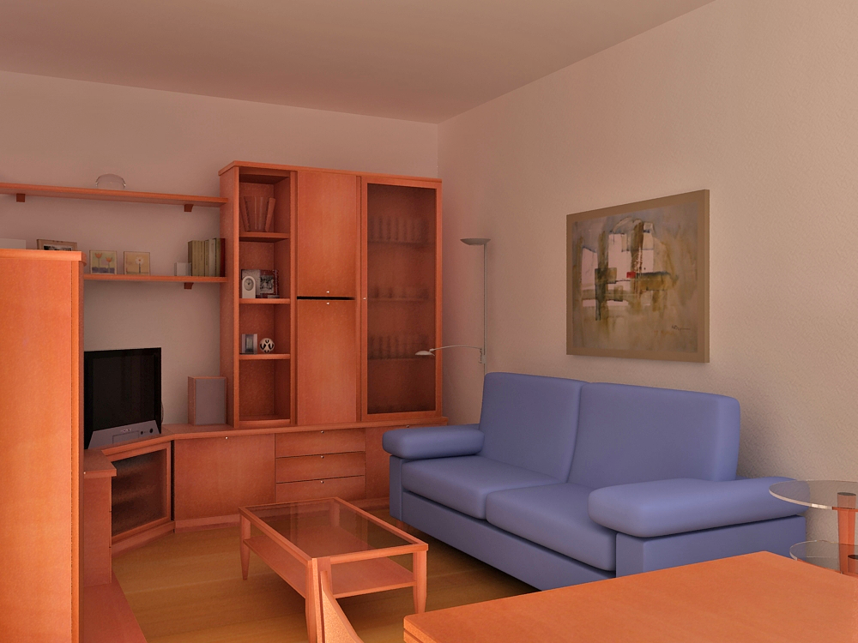
Homework
1. I am ____ student.
2. He is ___ grocer.
3. Banaras is ____ holy city.
4. The world is ___ happy place.
5. Sanskrit is ___ difficult language.
6. Rama has come without __ umbrella.
7. She is ___ untidy girl.
8. He is ___ able teacher.
9. She has made ___ mistake.
10. Do not make ___ noise.

Slide 29
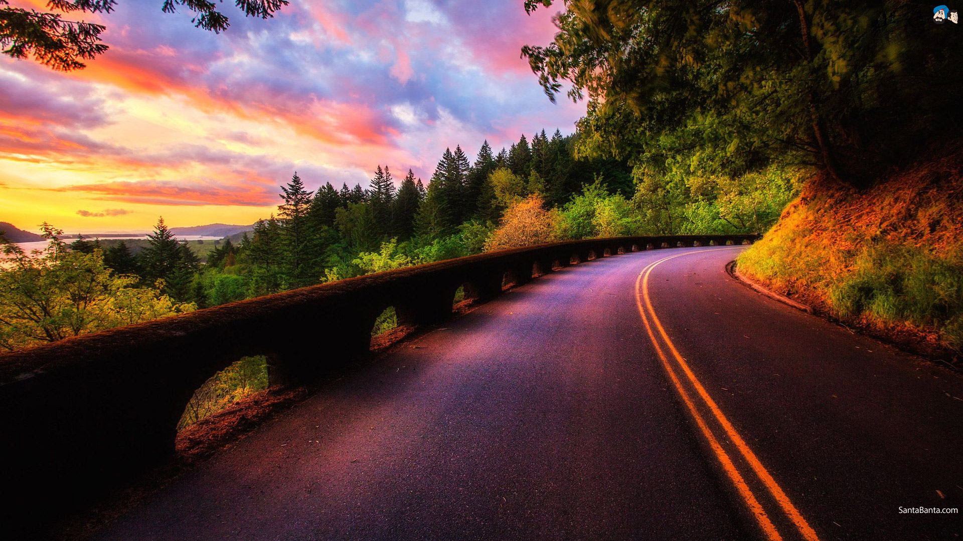
Thanks

